Slide 1
Codename: SugarTrail
Infrastructure-less indoor
location guidance

Slide 2
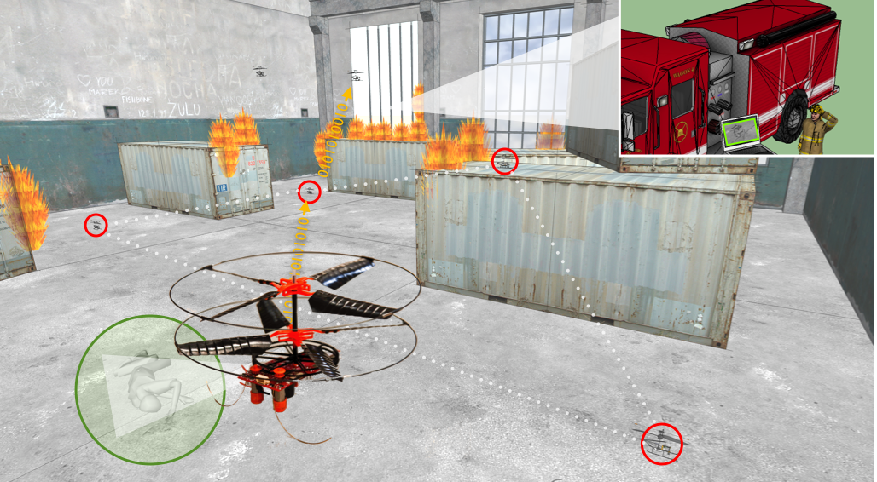
Why?
Notes:
Why is it important: the self-deplored guiding system can help firefighters searching in the building, while generating

Slide 3
Why?
Navigation
Leading people to the point of interest is sufficient, as opposed to knowing it’s absolute location on a map.
Emergency Response – Fire
Unknown environment
No infrastructure
Need for navigation
Locating Things – Walmart/ Old people’s home
Low cost infrastructure
Quick and easy to deploy and maintain
Need for navigation

Slide 4
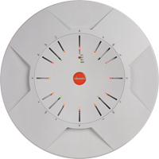
Why?
Existing location systems
Signature Based Wi-Fi
Coarse-grained
Calibration
Camera (Slam)
Resource intensive
Privacy
GPS-like Range Based Ultrasound/UWB (Slam)
Need infrastructure

Slide 5
What? SugarTrail!
Self-configuring indoor navigation system
No pre-existing infrastructure needed
No manual calibration required

Slide 6
How?
Signatures
Clusters
Local Compass Signatures
Virtual Maps

Slide 7
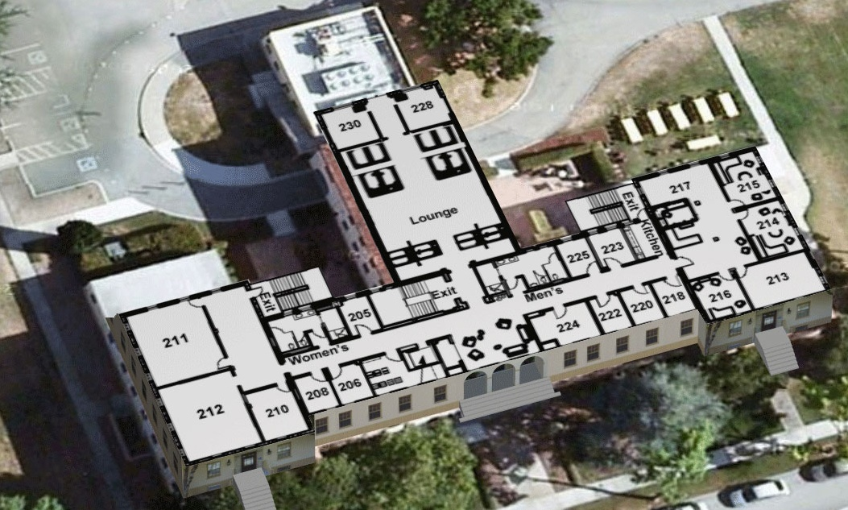
Guidance
Landmark: stairs
Destination: Pei’s office
Landmark: sofa
Start: front door, 1st floor

Slide 8
Signatures
Round-trip time-of-flight (RToF) readings from arbitrarily placed anchor nodes.
{r1, r2, r3, r4, …, rN}
RToF readings are stable over time for a particular room geometry but show high error

Slide 9
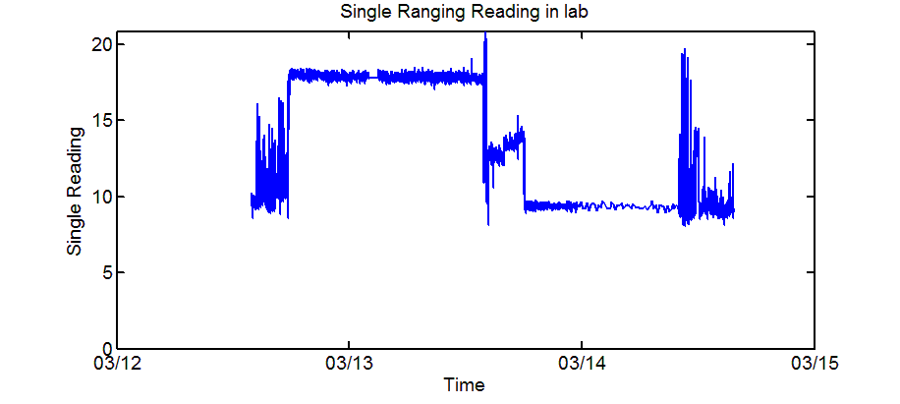
Signatures: Single Ranging Reading
Block Anchor 11 at March 12th 16:43
Move block away at March 13th 15:10

Slide 10
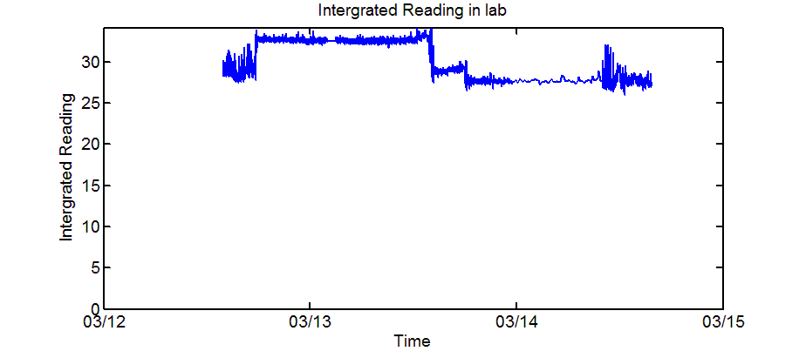
Signatures: Integrated Ranging Reading

Slide 11
Clusters
Signatures can be clustered by a distance threshold to create virtual landmarks.

Slide 12
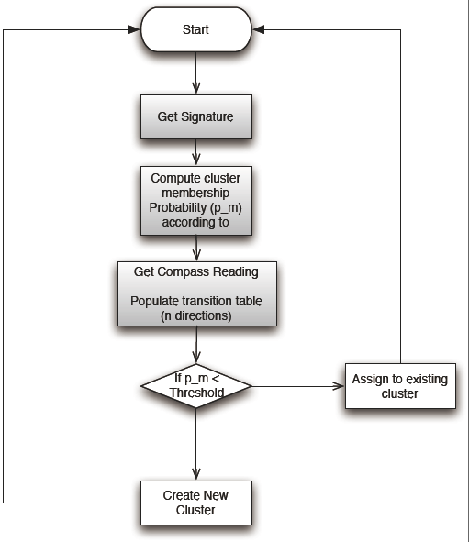
Clustering

Slide 13
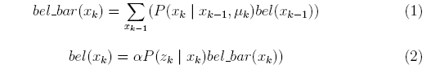
Algorithm: Bayesian Filter
Possibility of one step away from Cluster in direction ending up in Cluster
Given current reading and direction , the belief of in Cluster

Slide 14
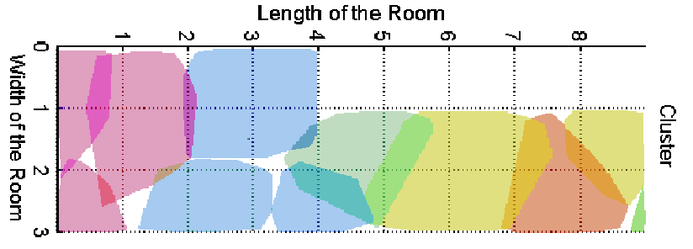
Clusters

Slide 15
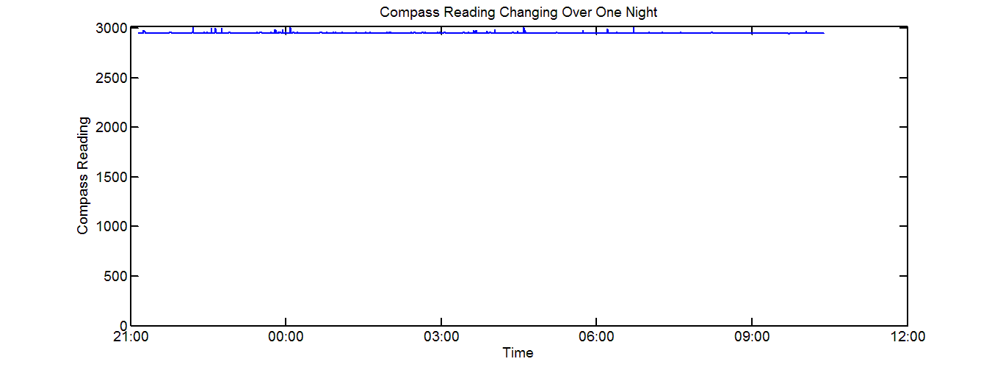
Local Compass Signatures
The compass reading differs in different environment
What we need is relative direction ( like, ‘turn left’ )

Slide 16
Experiment in Hallway
Using relation between real distance and ranging reading to get complete signatures
Using generated signatures to get distribution table for possibility of signature belongs to certain cluster
Clustering
Navigation
Kmeans Re-cluster

Slide 17
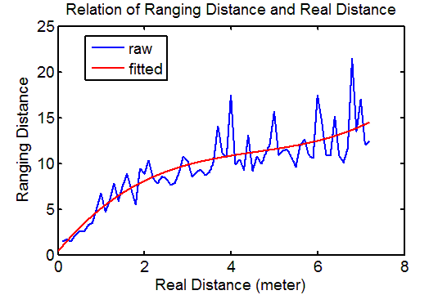
Real Distance & Signature

Slide 18
Clusters

Slide 19
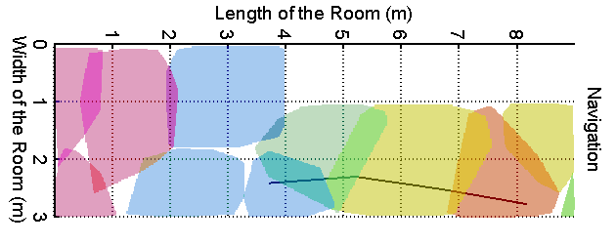
Navigation

Slide 20
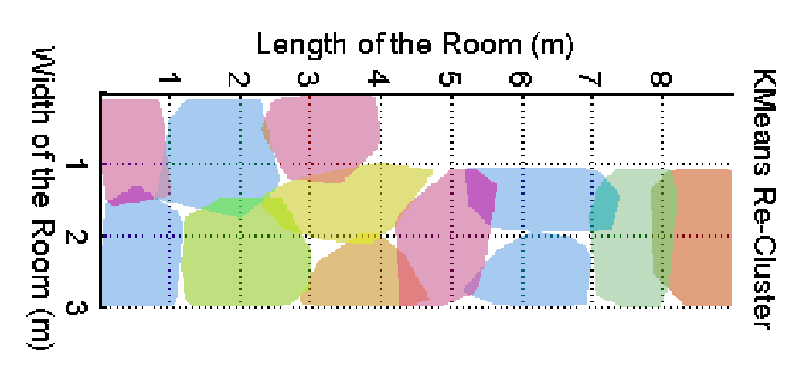
Kmeans Re-Clusters

Slide 21
Metric
Average Distance Error: to measure the accuracy of the guiding system
Average Step: to measure how well the guidance is on choosing path

Slide 22
Parameters
Number of Anchors
At least 4
Tested from 4 to 12
Distribution Table (the clusters size)
Tested from 0.5 to 3

Slide 23
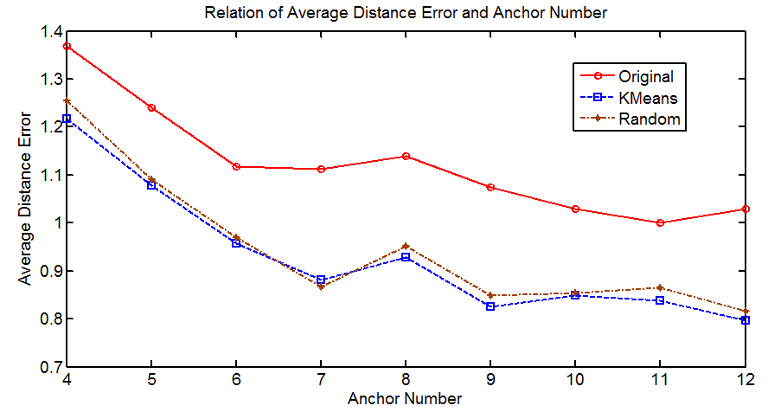
Number of Anchors

Slide 24
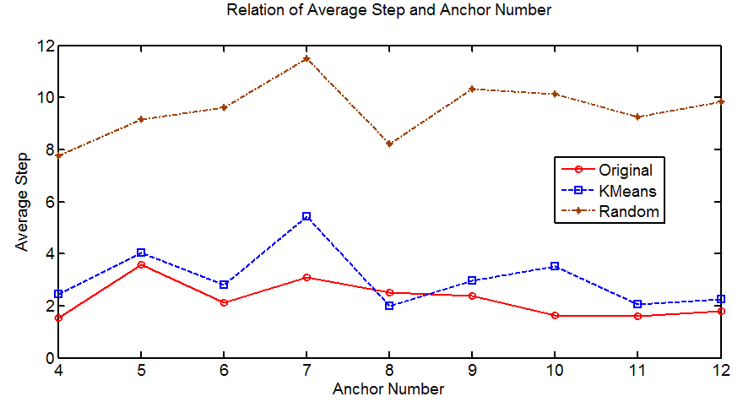
Number of Anchors

Slide 25
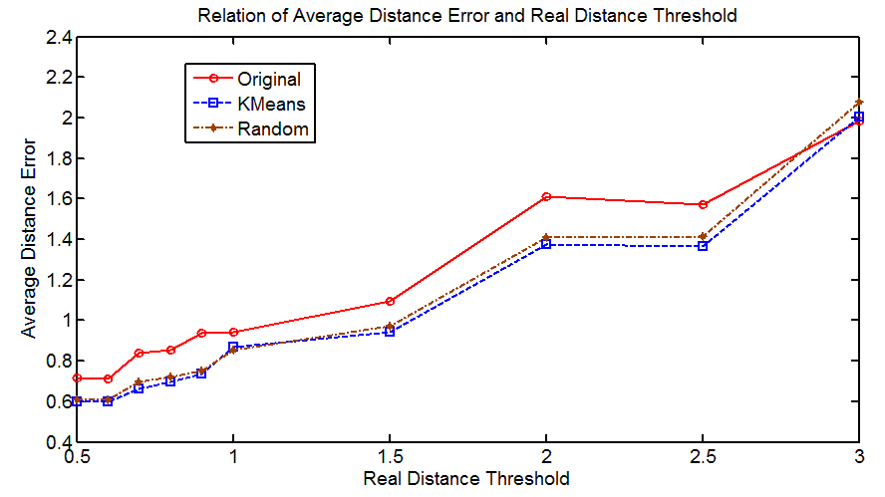
Distribution

Slide 26
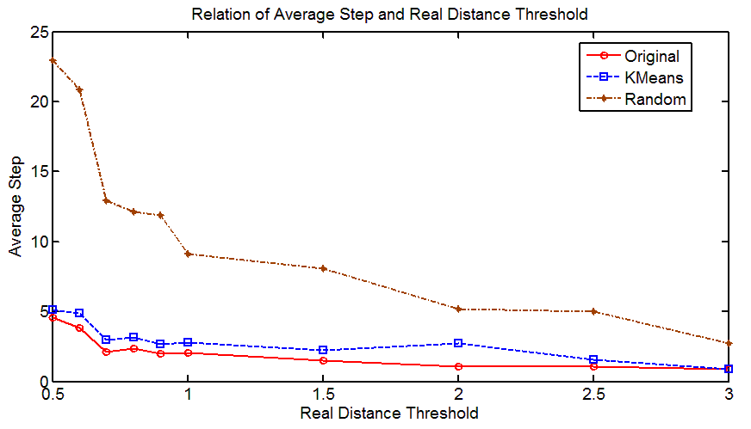
Distribution

Slide 27
Experiment in Lab
Collecting Ranging Signatures and Compass Readings every 10 centimeters
20 ranging signatures for one point
1 Compass reading
Randomly pick readings as training trail
Filtering readings in signature by their stand deviation
Using subset of the signatures for clustering

Slide 28
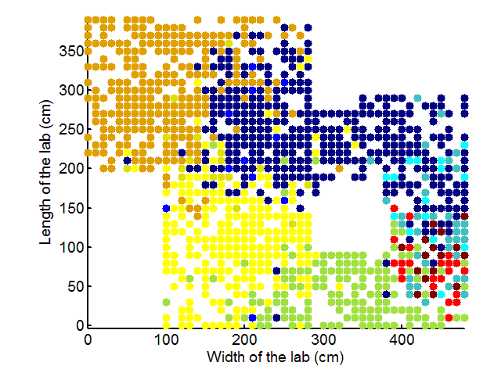
Experiment in Lab

Slide 29
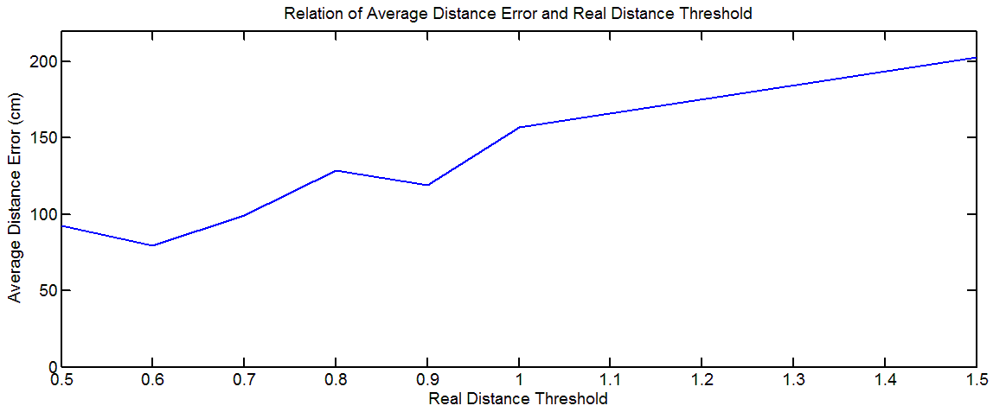
Experiment in Lab

Slide 30
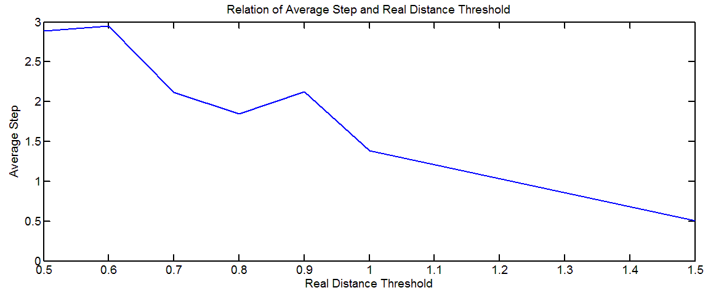
Experiment in Lab

Slide 31
Experiment in Supermarket
Ranging Test
How long can it rang?
Where to put anchors?
Clustering Test
Can area across racks be distinguished?
Can area alone the racks be distinguished?

Slide 32
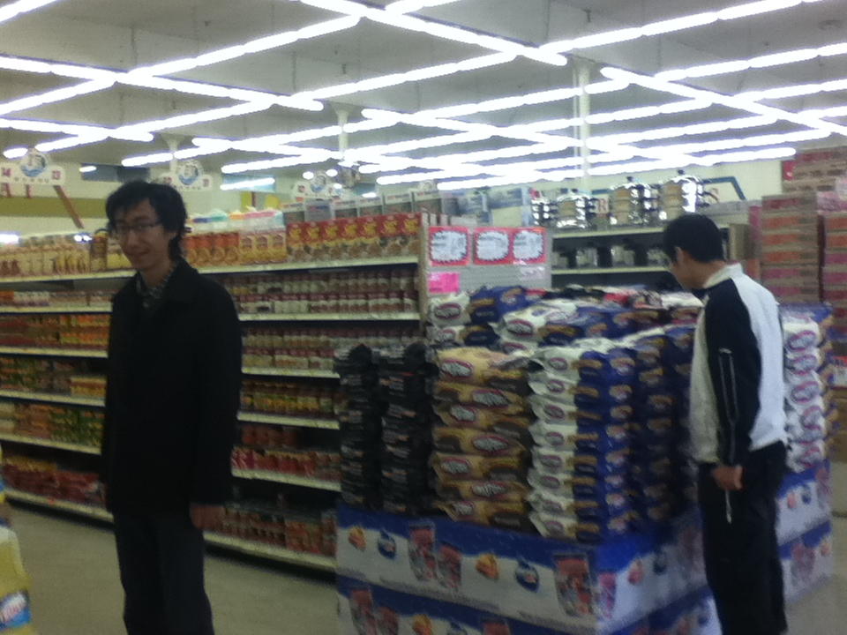
New Wing Yuan Market: Environment

Slide 33
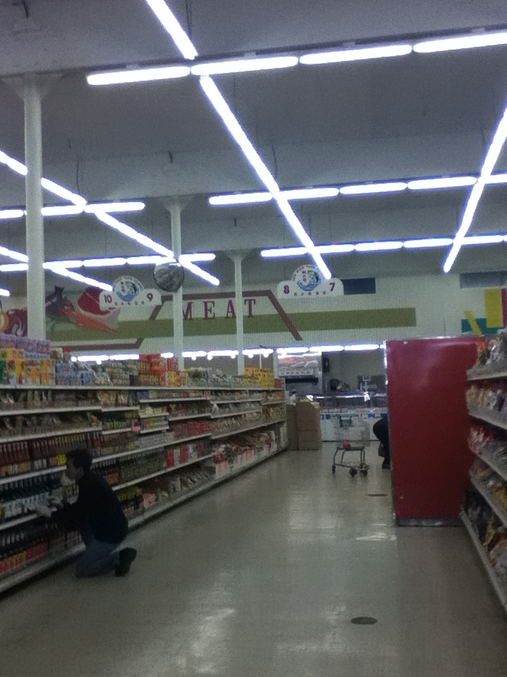
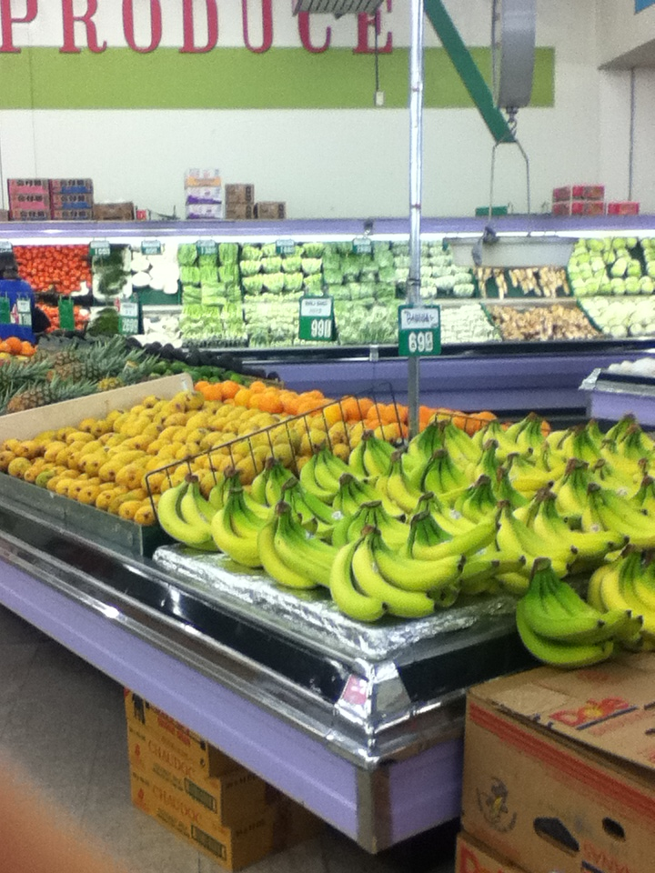
New Wing Yuan Market: Environment

Slide 34
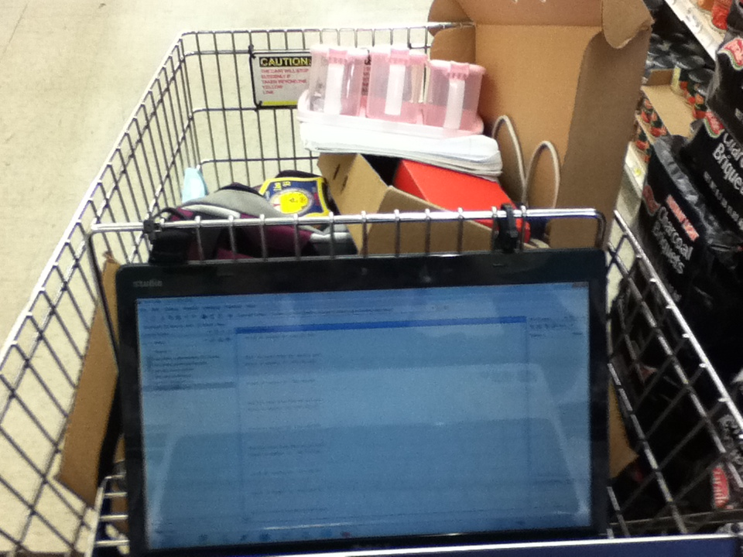
Equipments: Laptop
Connect Base to the laptop
Use Matlab serial port get data directly

Slide 35
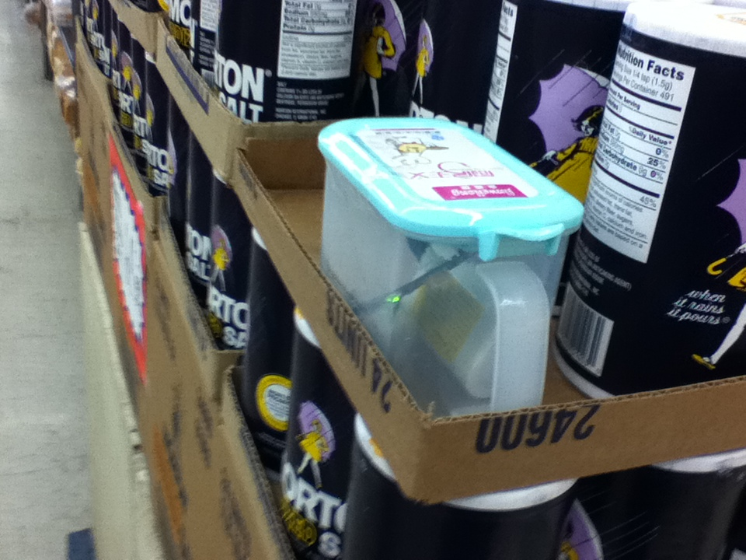
Equipments: Anchor
Anchor

Slide 36
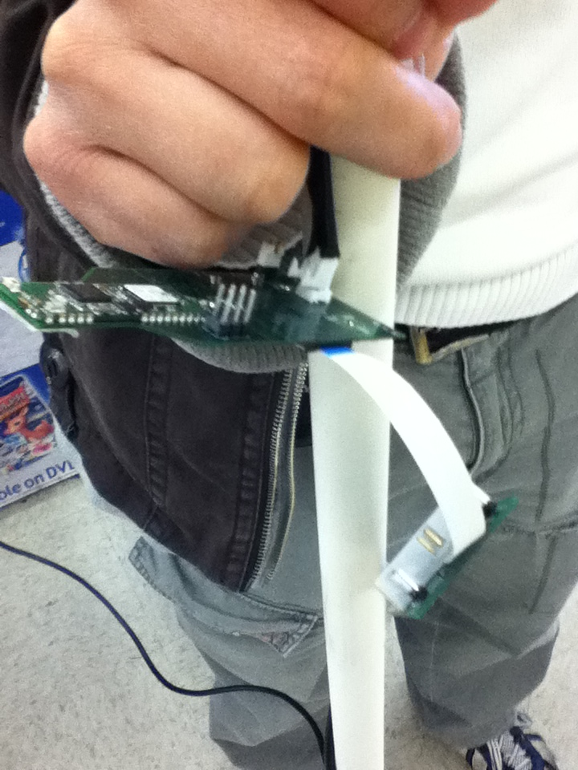
Equipments: Node and Base
Base and Node align vertically

Slide 37
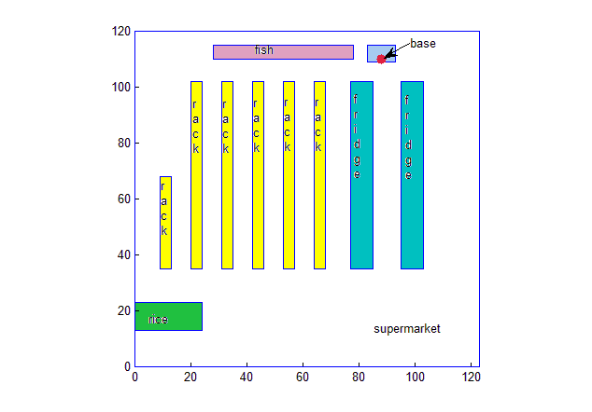
Ranging Test: Along Aisle

Slide 38
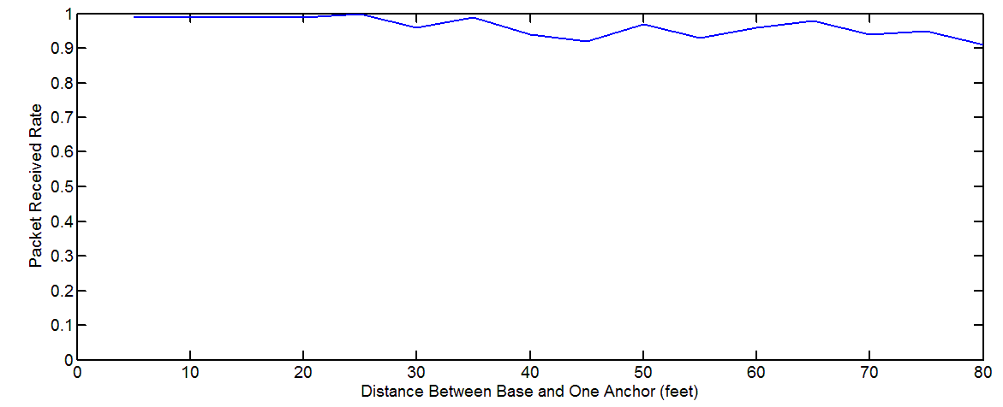
Ranging Test: Along Aisle

Slide 39
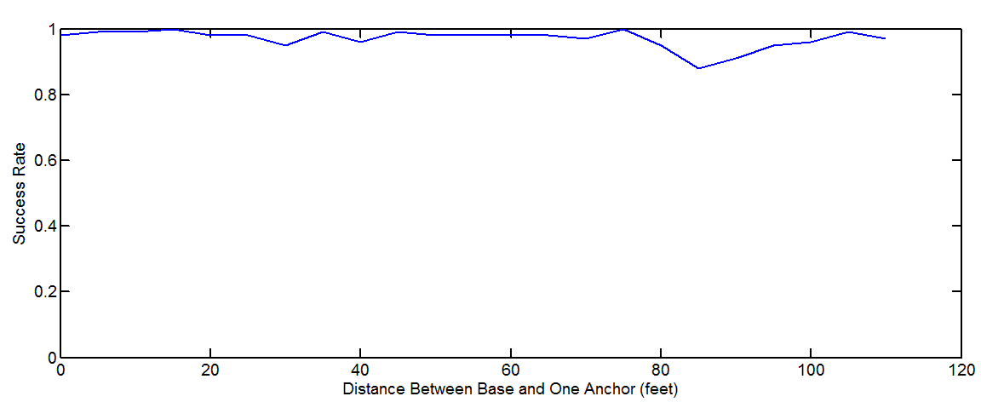
Ranging Test: Along Aisle

Slide 40
Ranging Test: Along Aisle

Slide 41
Ranging Test: Along Aisle Across Rack

Slide 42
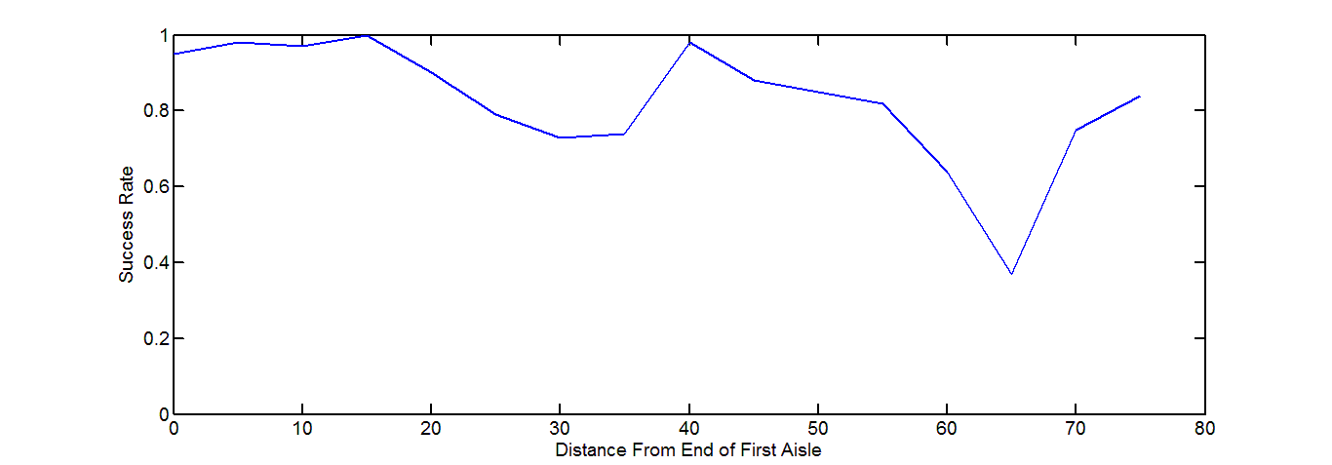
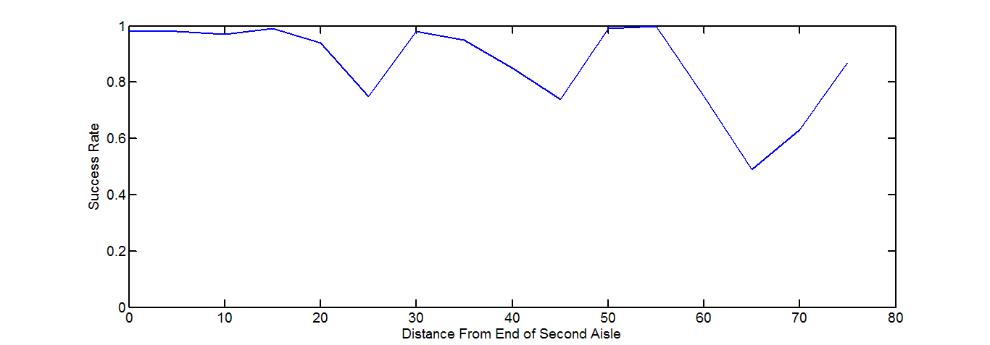
Ranging Test: Along Aisle Across Rack
First Rack
Second Rack

Slide 43
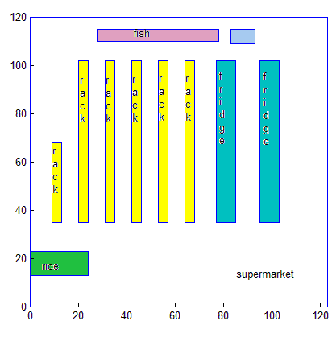
Ranging Test: Across Racks

Slide 44
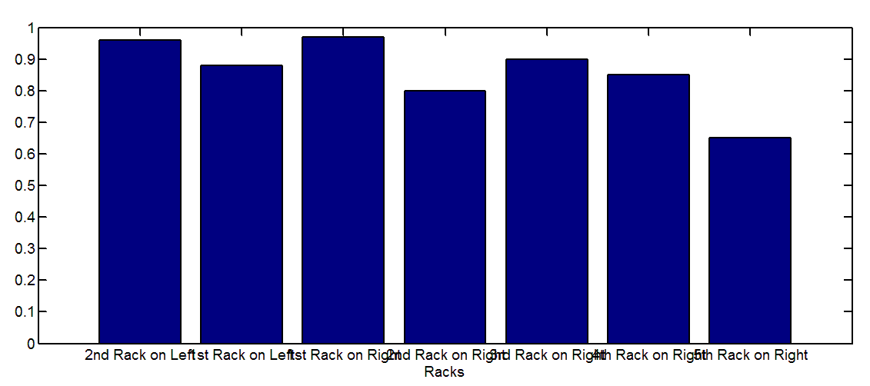
Ranging Test: Across Racks

Slide 45
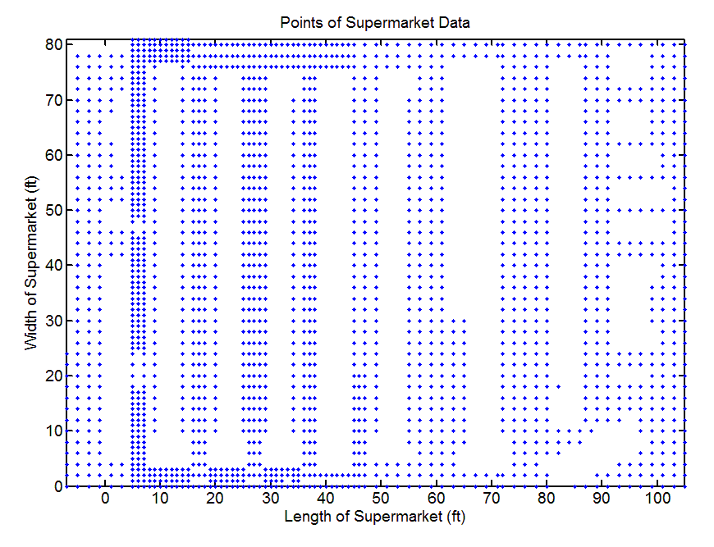
Organized Data Collecting: Sample points

Slide 46
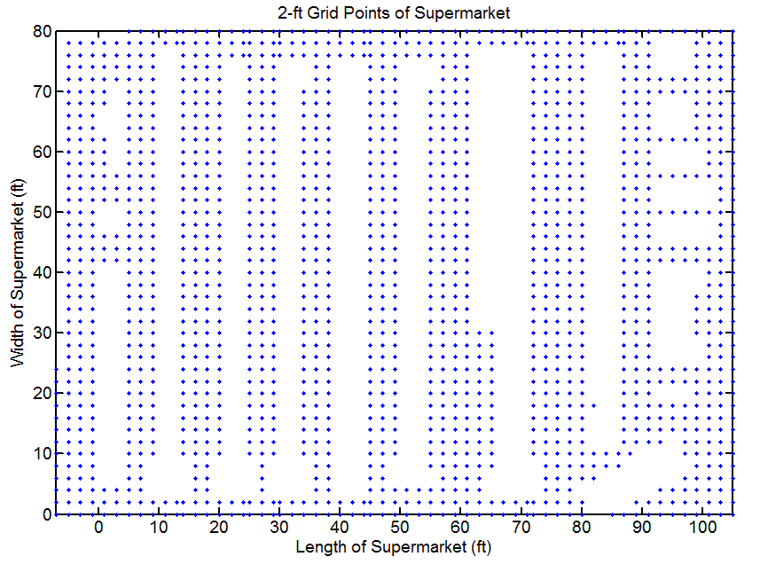
Filter the Data for Our Use: 2x2 feet grid

Slide 47
Clustering: Using sub-set of signature
Using sub-set of signature in Clustering
Comparing 2 readings’ overlapped signature readings number
If > valid_sig_threshold : use corresponding distribution table to determine if they are in same cluster
Else : considering them in 2 different clusters

Slide 48
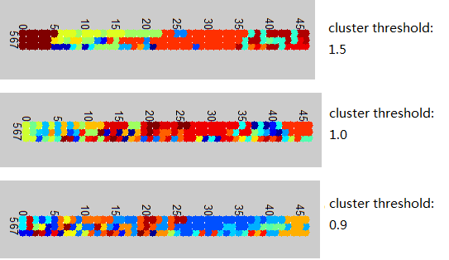
Clustering on One Aisle

Slide 49
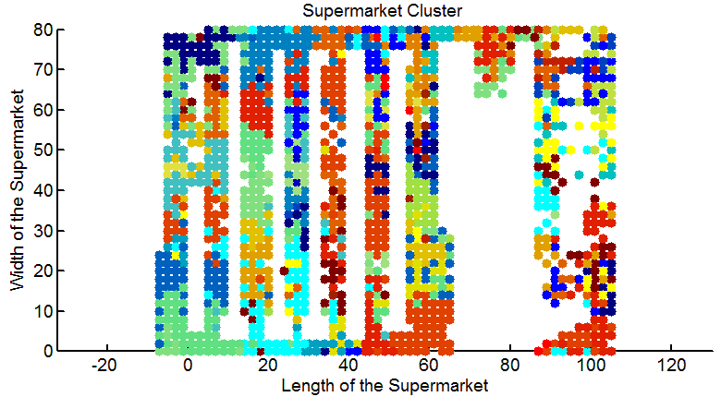
Clustering over whole supermarket

